Slide 1

Vel Tech Rangarajan Dr. Sagunthala R&D Institute of Science and Technology
School of Computing
Department of Computer Science and Engineering
10211CS224 / FULL STACK APPLICATION DEVELOPMENT (JAVA)
END SEMESTER PROJECT REVIEW
Date: 06-05-2026
Smart Campus Event Management System
SDG: 9 – Industry, Innovation and Infrastructure
Presented By:
D.Anusha – VTU26642 – 23UECS0137
Courses Handling Faculty:
Dr.Hafizur Rahman,
Assistant Professor

Slide 2
INTRODUCTION
1
Traditional campus event management is mostly manual and inefficient.
It leads to difficulties in registration, tracking, and communication.
This project aims to provide a centralized digital solution.
It simplifies event browsing, registration, and management.
The system improves student participation and engagement.
It ensures secure access and accurate data handling.
The application uses modern web technologies for better performance.
Overall, it provides an efficient and user-friendly event management platform.
2
3
4
5
6
7
8
9

Slide 3
PROBLEM STATEMENT
1
2
Existing campus event management systems rely heavily on manual processes.
This leads to inefficiency in handling registrations and event coordination.
There is no centralized platform to manage all events effectively.
Tracking participant details and event data becomes difficult.
Manual systems increase the chances of errors and data loss.
Communication between students and organizers is often limited.
There is a need for a secure and automated system.
The proposed solution aims to improve efficiency, accuracy, and accessibility.
3
4
5
6
7
8
9

Slide 4
OBJECTIVE(S)
1
Key Objectives:
2
3
To develop a web-based system for efficient campus event management
To enable easy event registration and secure user authentication
To provide automated ticket generation and admin analytics
4
5
6
7
8
9

Slide 5
PROPOSED SYSTEM
1
The system is a web-based platform for managing campus events
Provides a centralized solution for students and administrators
Allows users to browse, select, and register for events online
Ensures secure login and user authentication
Automates event registration and data storage
Generates PDF tickets after successful booking
Provides admin dashboard with charts and analytics
Improves efficiency, reduces errors, and enhances user experience
2
3
4
5
6
7
8
9

Slide 6
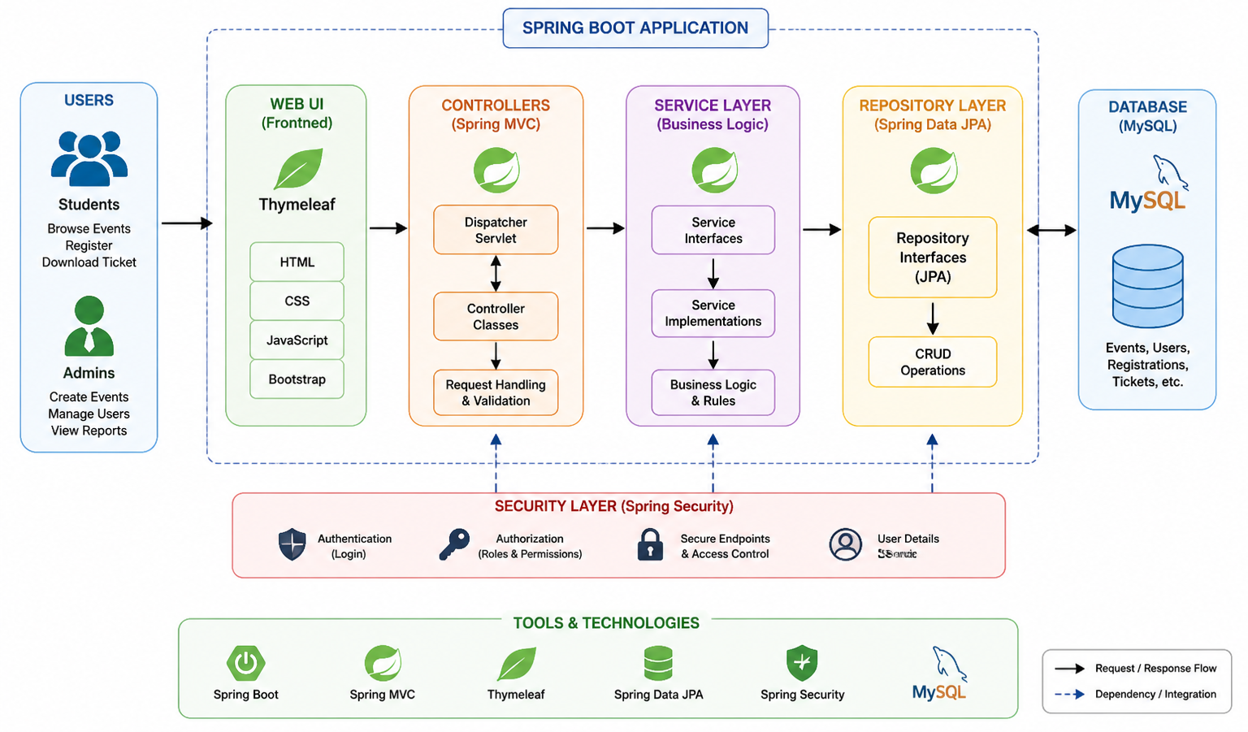
PROPOSED SYSTEM ARCHITECTURE
1
2
3
4
5
6
7
8
9
Fig-1 :Proposed System Architecture

Slide 7
Input
User login and registration details
Event search and selection inputs
Admin inputs for event creation and updates
Processing
Requests handled by Spring MVC Controllers
Business logic executed in Service Layer
Data validation and request handling performed
Secure authentication using Spring Security
Database
MySQL database used for data storage
Stores users, events, registrations, and tickets
Managed using Spring Data JPA (CRUD operations)
Output
Displays event details and registration status
Generates PDF tickets after booking
Shows admin dashboard with charts and analytics

Slide 8
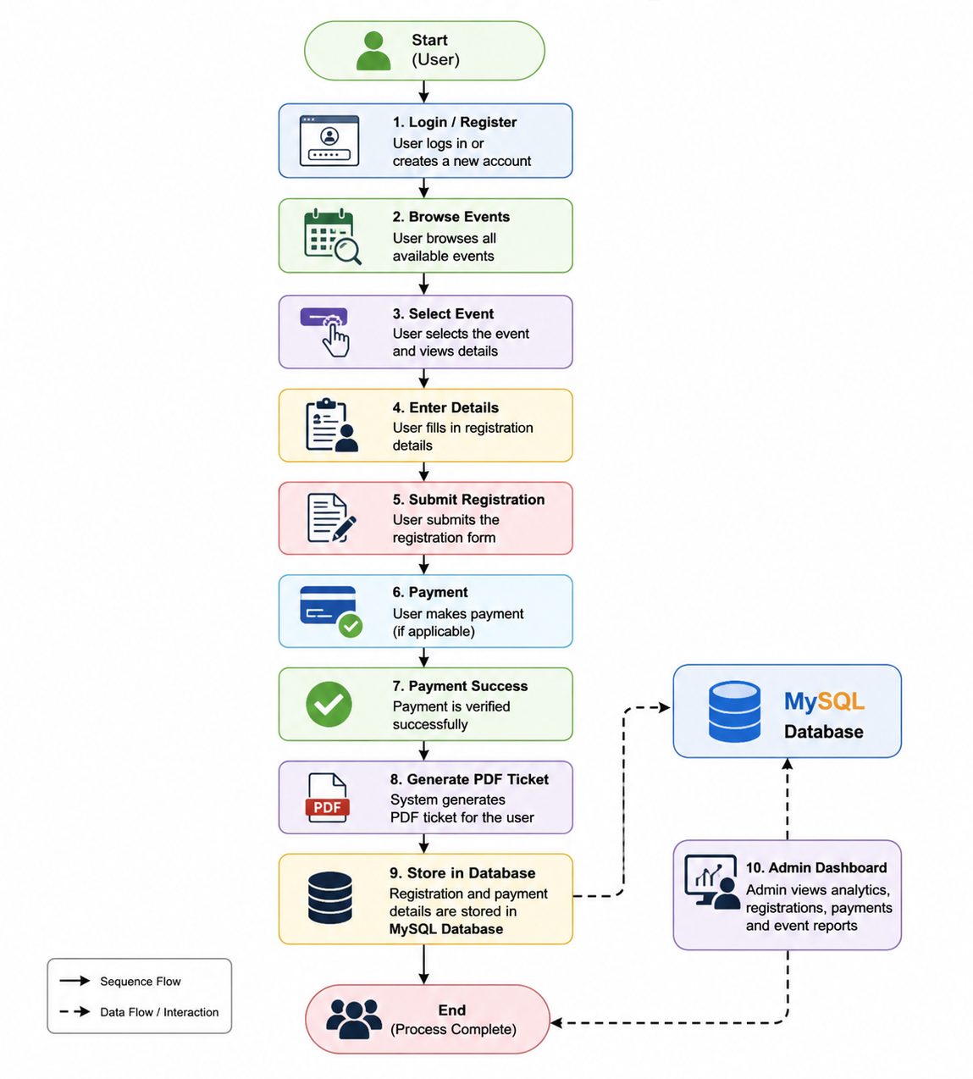
WORKFLOW
1
2
3
4
5
6
7
8
9
Fig-2 : Work Flow

Slide 9
TECHNOLOGIES USED
Frontend: HTML, CSS, Thymeleaf
Backend: Spring Boot, Spring MVC, Spring Security
Database: MySQL
Third-Party API:
Java Mail API (for OTP verification) (if you used it)
FPDF / PDF Library (for ticket generation)
Tools: Eclipse, Maven
Hardware/Software Requirements:
Processor: Intel i3 or above
RAM: Minimum 4GB
OS: Windows/Linux
Browser: Chrome/Edge
1
2
3
4
5
6
7
8
9

Slide 10
MODULE DESCRIPTION
Module 1: User Authentication
This module handles the registration and login functionality of users. It allows new users to create an account and existing users to log in securely using their credentials. The system uses authentication mechanisms to ensure data security and restrict unauthorized access. It also manages user sessions after successful login. Module 2: Event Management
This module is responsible for managing all event-related activities. The administrator can add, update, and delete event details such as title, date, location, and description. Users can view the list of available events and select events based on their interests. Module 3:Registration and Ticket Generation
This module enables users to register for selected events by entering their personal details. Once the registration is completed successfully, the system displays a confirmation or payment success page. It also generates a PDF ticket containing event and user information.
Module 4: Admin Dashboard
This module provides an interface for administrators to monitor and control the system. It displays event statistics and user participation using charts and reports. The admin can analyze data and manage the overall functioning of the system efficiently.
1
2
3
4
5
6
7
8
9

Slide 11
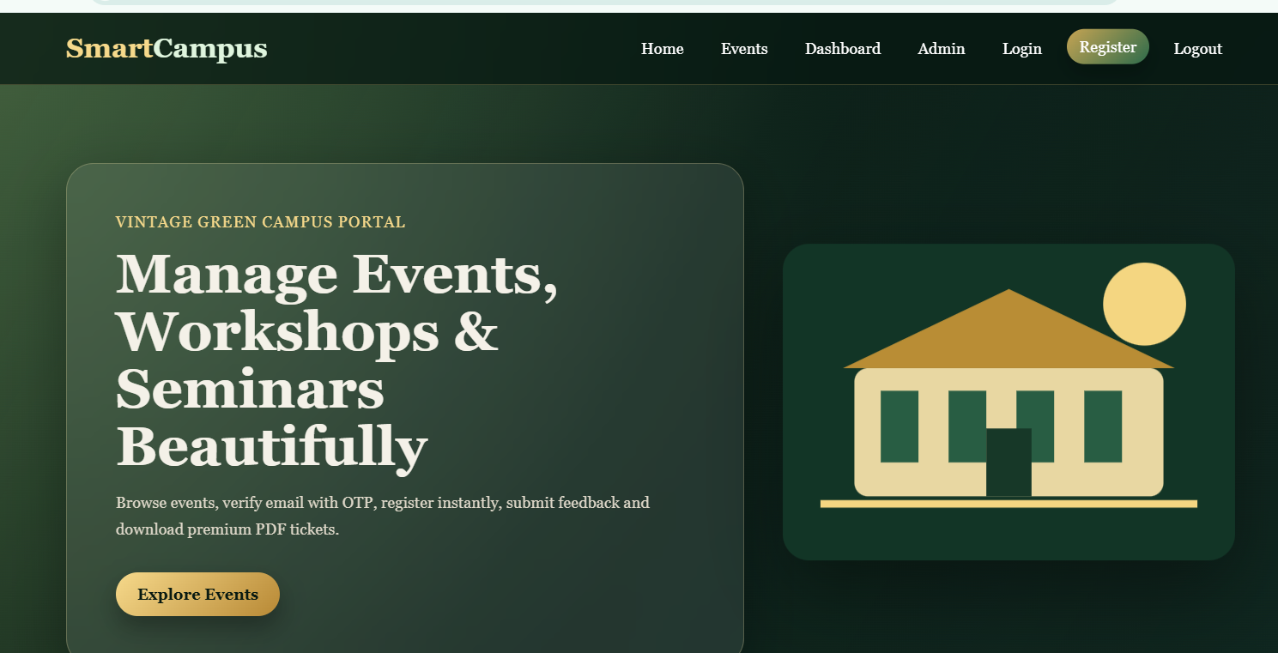
IMPLEMENTATION SCREENSHOTS
1
2
3
4
5
6
7
8
Fig-3 : Home Page
The home page of the Smart Campus Event Management System provides a visually appealing interface for users to navigate the application. It allows users to explore events, register easily, and access different features through a clean navigation bar. The design uses a modern vintage theme to enhance user experience and engagement.
9

Slide 12
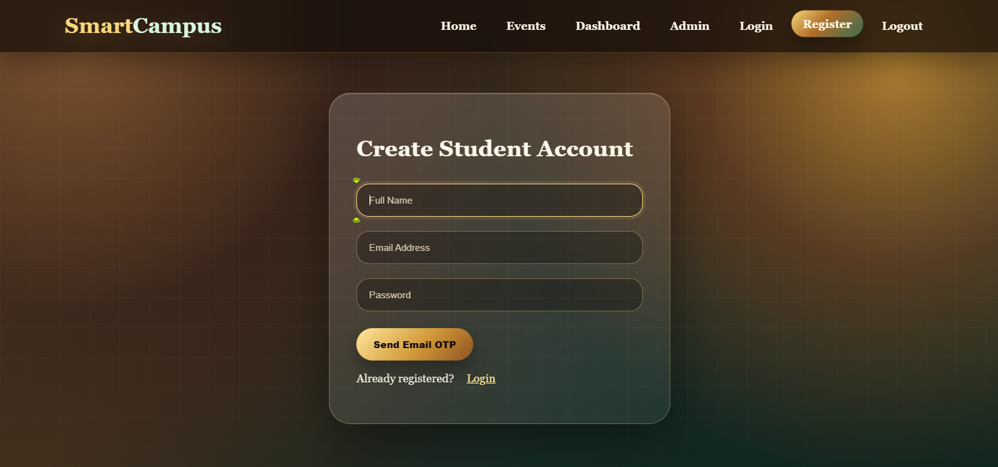
IMPLEMENTATION SCREENSHOTS
1
2
3
4
5
6
7
Fig-4 : Login Page
8(A)
The login page provides a secure interface for users to access the system after OTP verification. It allows users to enter their credentials and ensures authentication before granting access. The clean design and highlighted login form improve usability and user experience.
9

Slide 13
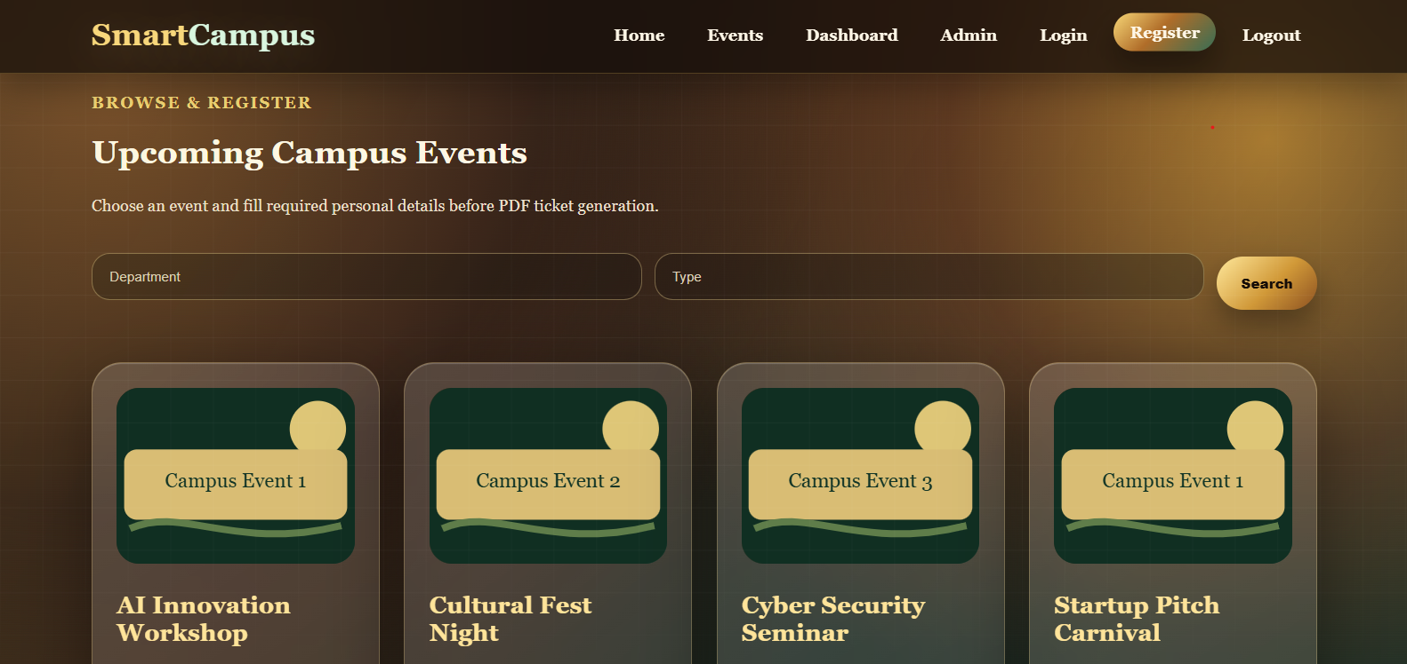
IMPLEMENTATION SCREENSHOTS
1
2
3
4
5
6
7
Fig-5 : Event Page
8(B)
The events page displays a list of upcoming campus events in an organized and visually appealing format. Users can browse events, apply filters, and select an event to register. It provides an easy way to explore and participate in various campus activities.
9

Slide 14
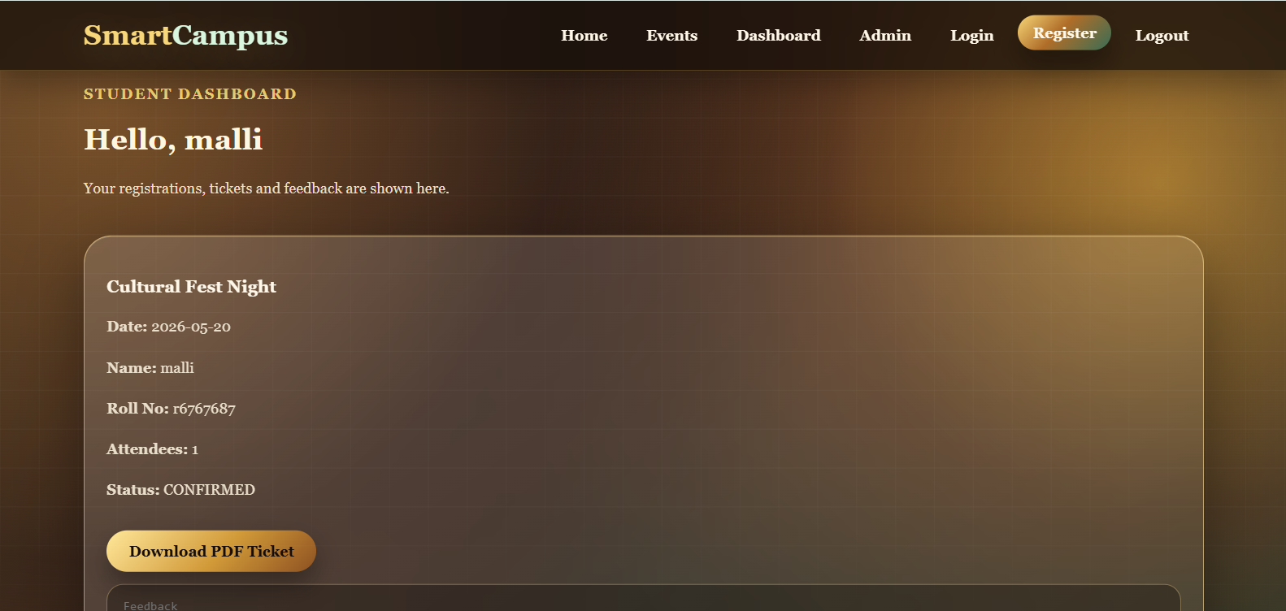
IMPLEMENTATION SCREENSHOTS
1
2
3
4
5
6
7
8(C)
Fig-6 : OutPut Page
The student dashboard displays the user’s registered events and related details such as date, attendee count, and booking status. It allows users to track their registrations and download PDF tickets easily. This page provides a personalized view for managing event participation efficiently.
9

Slide 15
IMPLEMENTATION SCREENSHOTS
Home Page of the application
Fig-7 : Home Page
The home page provides a user-friendly interface to navigate the system and explore available events. It allows users to quickly access features like event browsing and registration.”

Slide 16
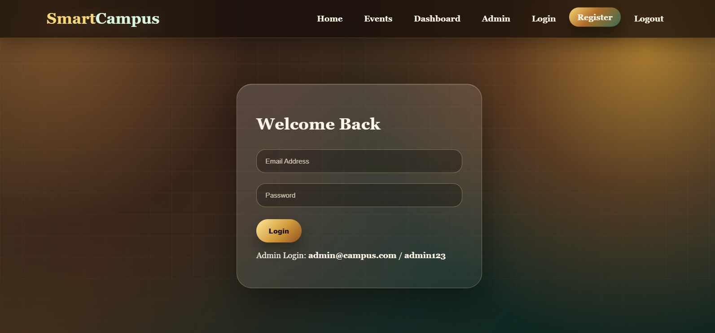
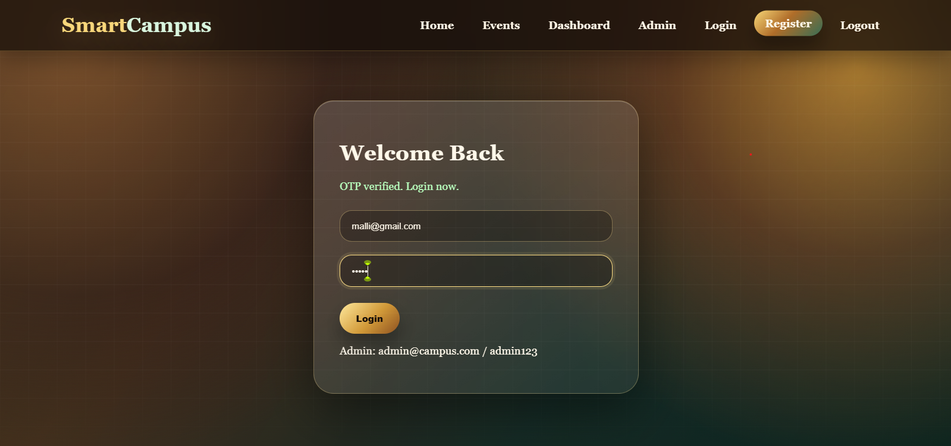
IMPLEMENTATION SCREENSHOTS
Admin Login Page
User Login Page
Fig-8 : Admin Login Page
Fig-9 : User Login Page

Slide 17
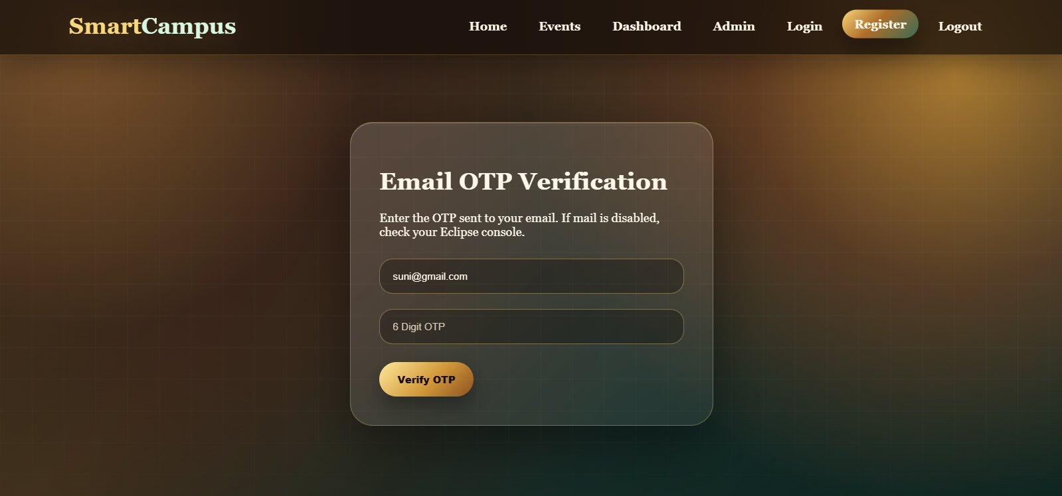
IMPLEMENTATION SCREENSHOTS
Module 1 : User Authentication
Fig- 10: User Authentication
This module manages user registration and login functionality. It ensures secure access using authentication mechanisms and verifies user credentials before allowing access. It also maintains user sessions after successful login.

Slide 18
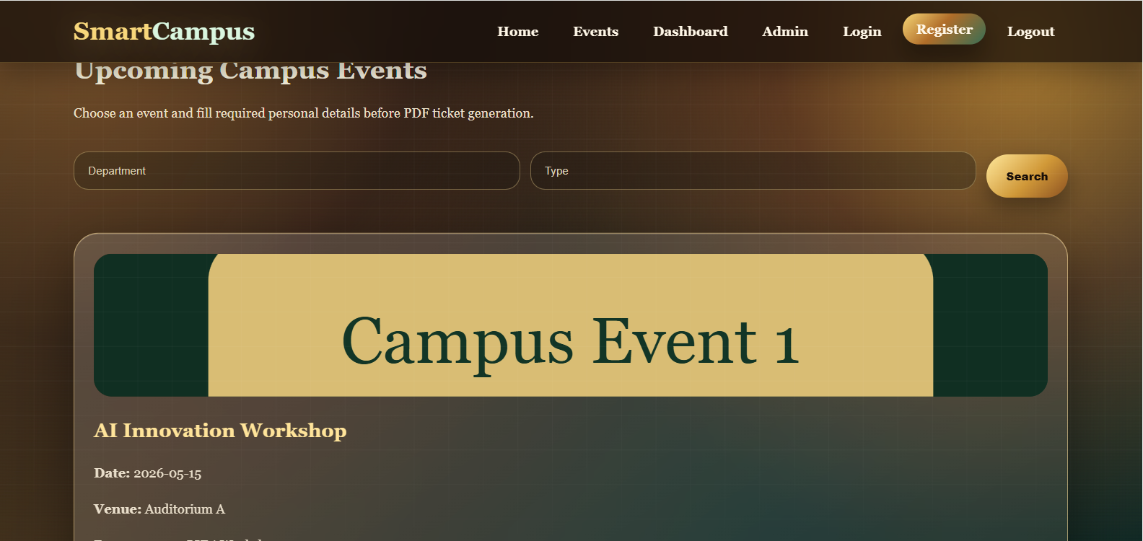
IMPLEMENTATION SCREENSHOTS
Module 2: Event Management
Fig- 11: Event Management
This module handles the creation, updating, and deletion of events by the administrator. It allows users to browse available events and view event details. It ensures proper organization and management of all event-related data.

Slide 19
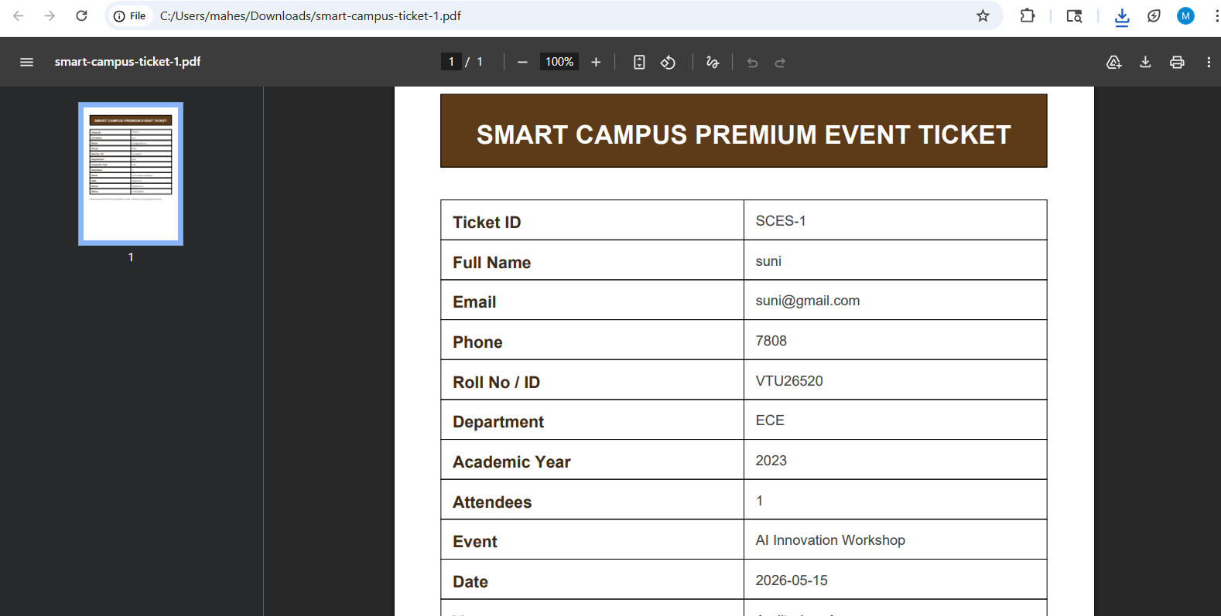
IMPLEMENTATION SCREENSHOTS
Module 3: Registration & Ticket Generation
Fig- 12: Registration & Ticket Generation
This module enables users to register for events by providing required details. After successful registration, the system confirms the booking and generates a PDF ticket. It simplifies the booking process and ensures proper record management.

Slide 20
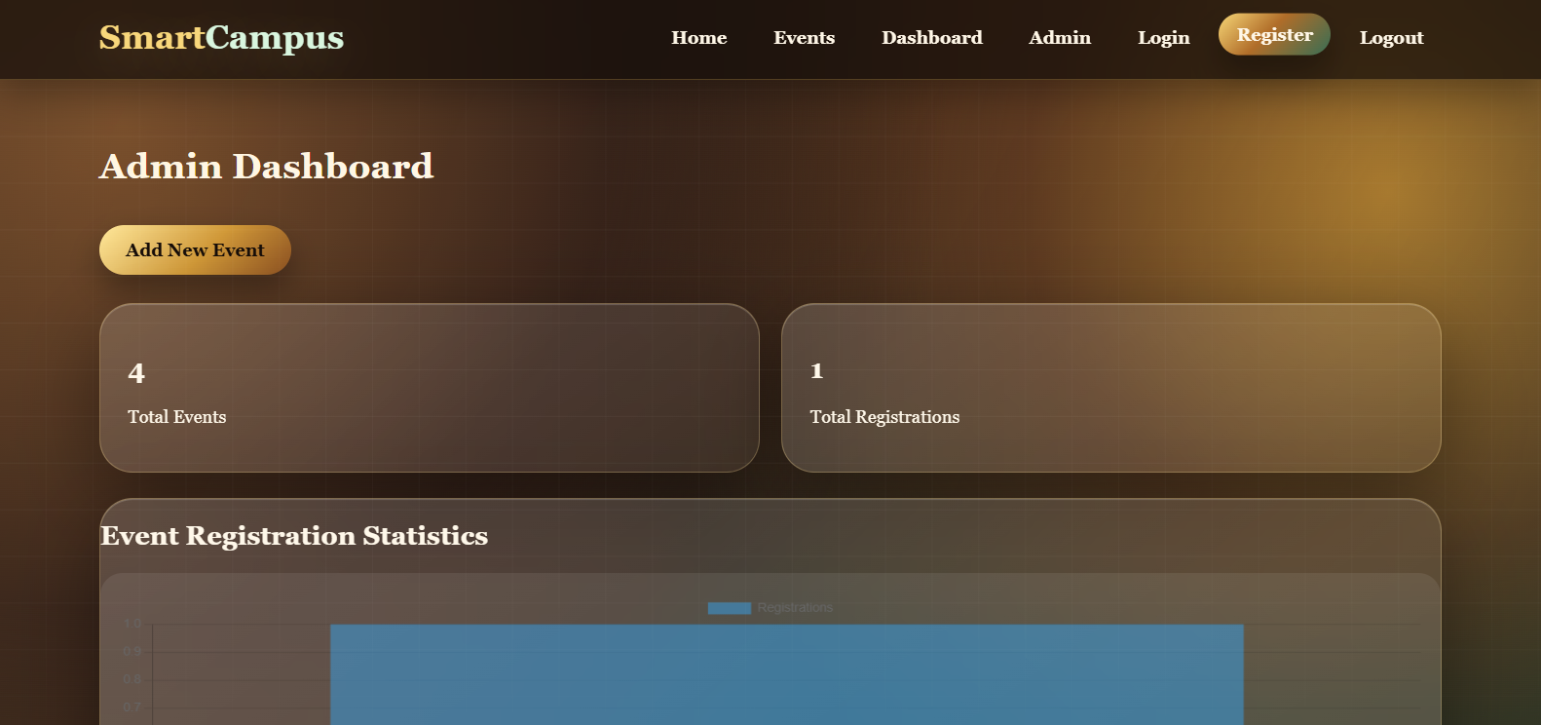
IMPLEMENTATION SCREENSHOTS
Module 4: Admin Dashboard
Fig- 13 : Admin Dashboard
This module provides an interface for administrators to monitor system activities. It displays event statistics and user participation using charts and reports. It helps in managing events efficiently and making informed decisions.

Slide 21
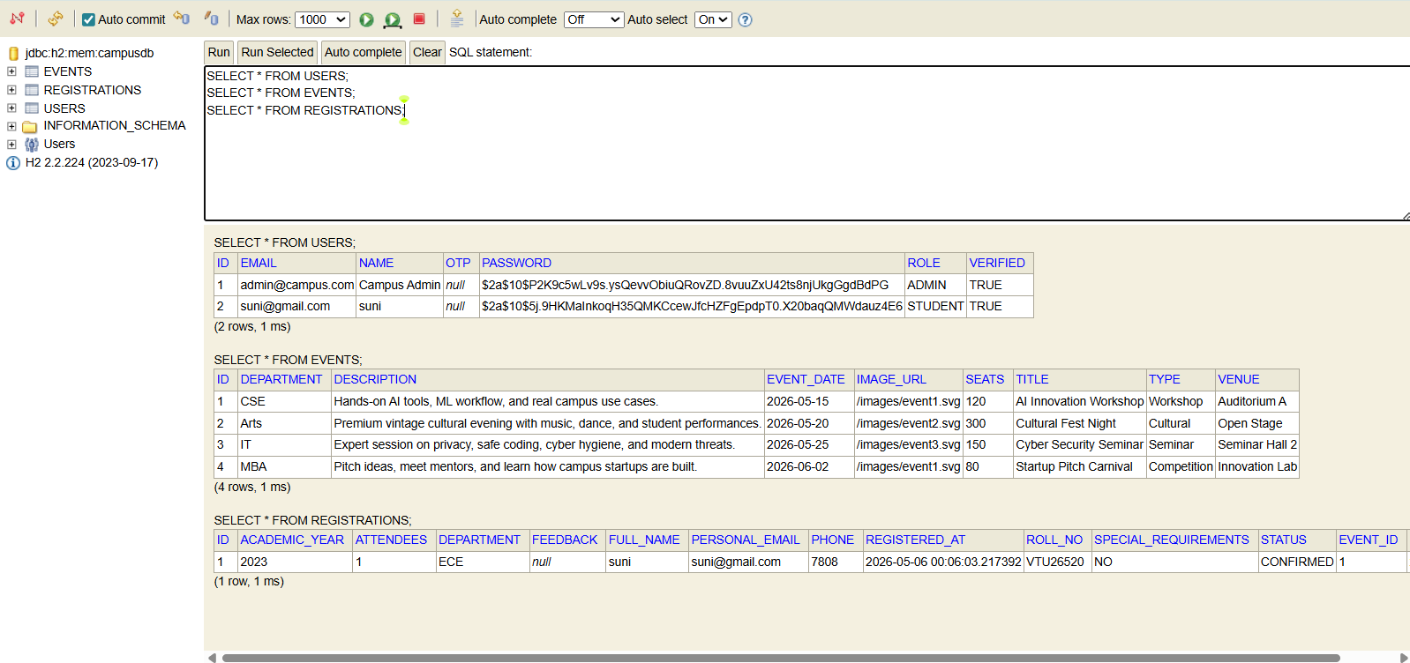
IMPLEMENTATION SCREENSHOTS
Database Screenshot
Fig- 14: Database Page

Slide 22
ADVANTAGES & LIMITATIONS
ADVANTAGES:
Provides a user-friendly and attractive interface
Reduces manual effort through automation
Ensures secure authentication and data handling
Enables easy online event registration
Generates PDF tickets automatically
Offers real-time data tracking and analytics
Supports centralized data management
Improves accuracy and reduces errors
1
2
3
4
5
6
7
Limitations :
Requires internet connectivity to access the system
Payment process is currently simulated (not real gateway)
Limited to web platform (no mobile app yet)
Depends on server and database availability
No real-time notifications (SMS/Email) implemented
8
9

Slide 23
Thank you

